Slide 1
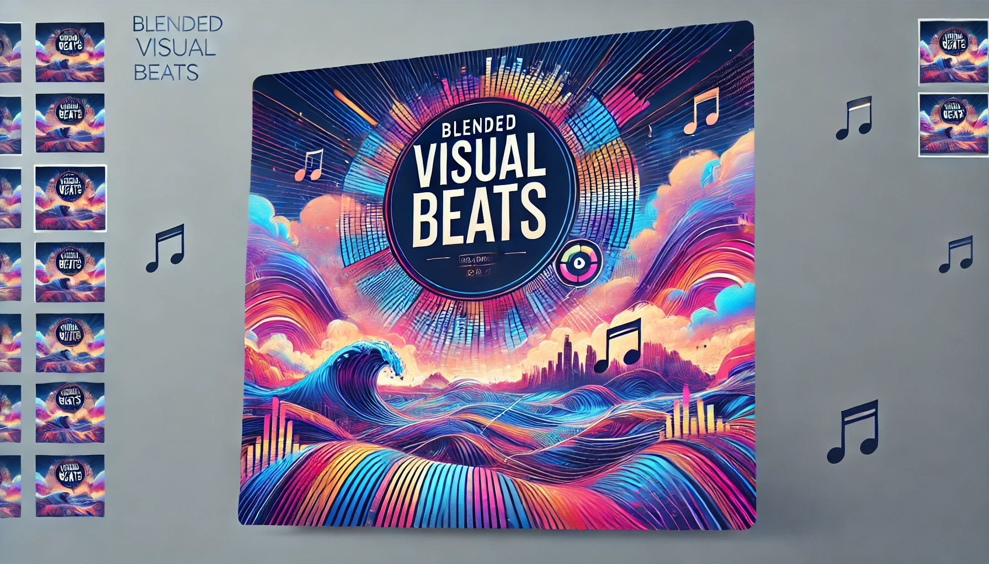
INFO-I 590 Data Visualization
Blended Visual Beats:
Visualizing Playlist Comparisons and Personalized Music Recommendations
Group 7
Swarn Gaba
Rutuja Jangle
Gandhar Ravindra Pansare
INDIANA UNIVERSITY BLOOMINGTON

Slide 2
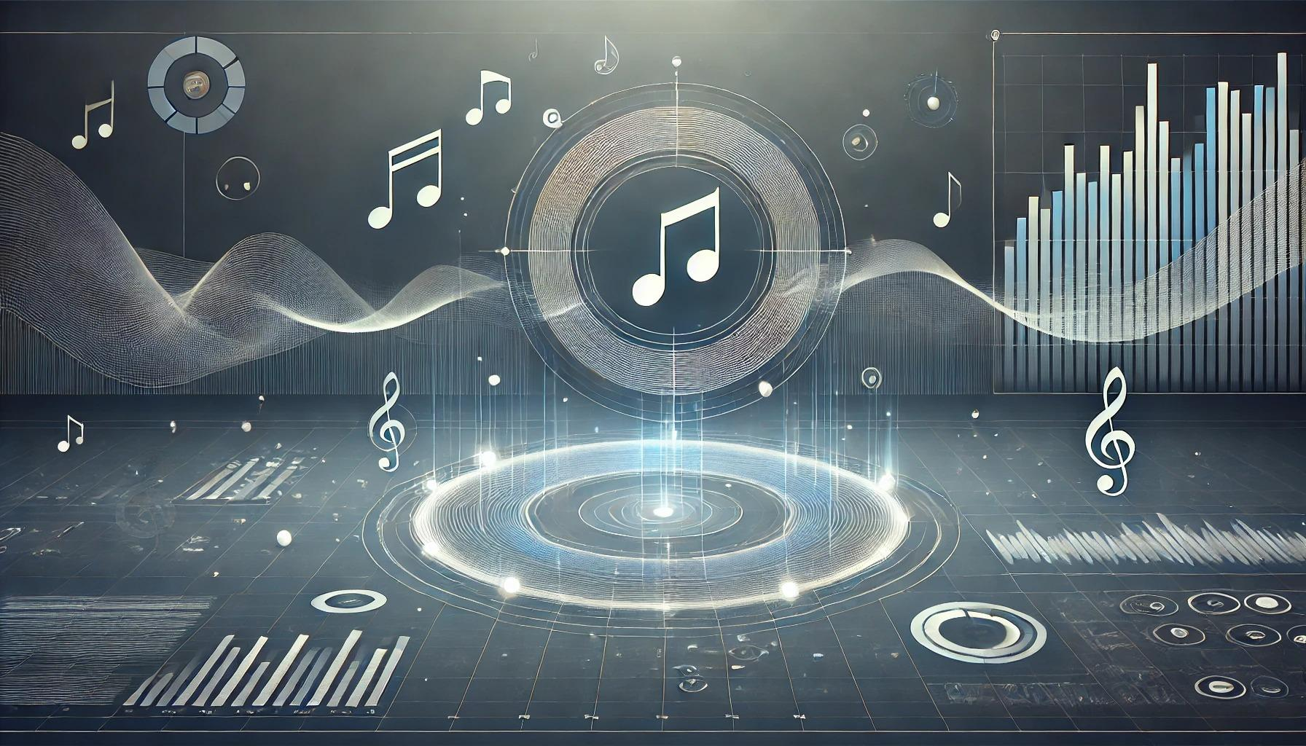
AGENDA
Introduction
Abstract
Demonstration
Outcomes
Learnings From Class Applied In Visualizations
End-To-End Workflow
Data Description
Data Exploration & Comparison
Key Aspects Explored in Our Visualization Process
References

Slide 3

INTRODUCTION
Music connects people, evokes emotions, and shapes cultures, highlighting its profound impact on society.
Music analysis helps uncover patterns, dissect compositions, and personalize experiences, enriching appreciation for this universal art form.
Spotify is the world’s most popular audio streaming subscription service^{[1]} with over 574 million users (226 million subscribers) across more than 180 countries. It is a rich source for data, and this data can be leveraged to do various analyses.

Slide 4
ABSTRACT
This project aims to:
Analyze and compare Spotify playlists to identify similarities and differences in musical traits like genres, artists, and energy.
Leverage these insights to generate personalized music recommendations.
Explore both static and dynamic visualizations, culminating in an interactive dashboard for users.
Key Features:
Visual comparison of musical attributes.
Data-driven personalized recommendations.
Intuitive and interactive visualizations for enhanced user experience.

Slide 5
DEMONSTRATION
Enhance your digital experience with tailored based music recommendations.
It's just a click away - to explore with
Blended Visual Beats
http://127.0.0.1:8080/

Slide 6
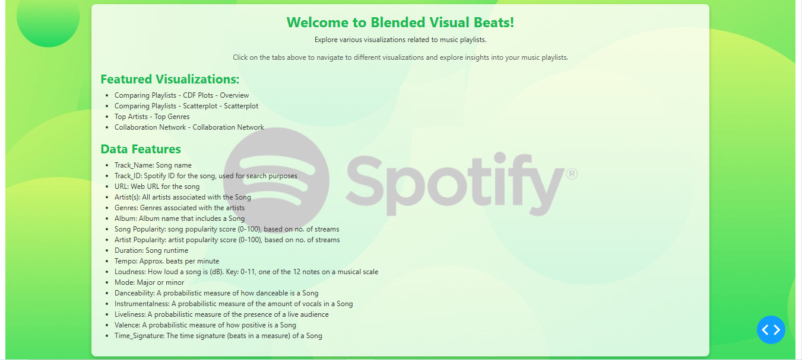

Slide 7
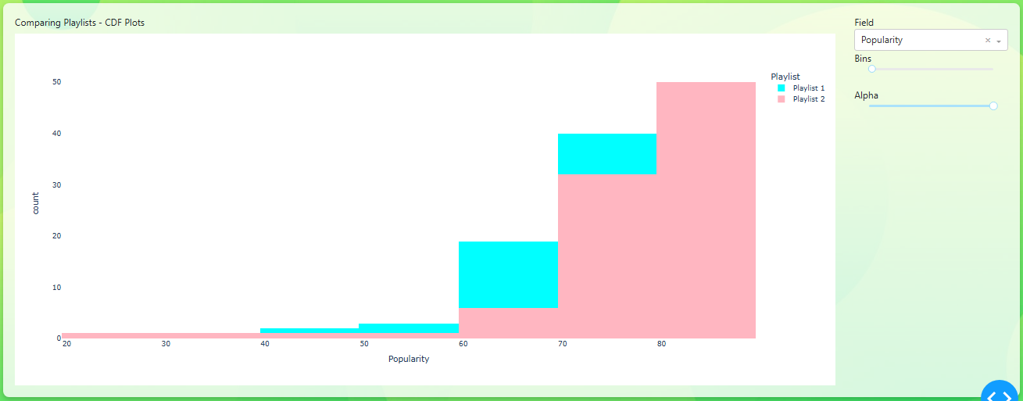
COMPARING PLAYLISTS - CDF PLOTS

Slide 8
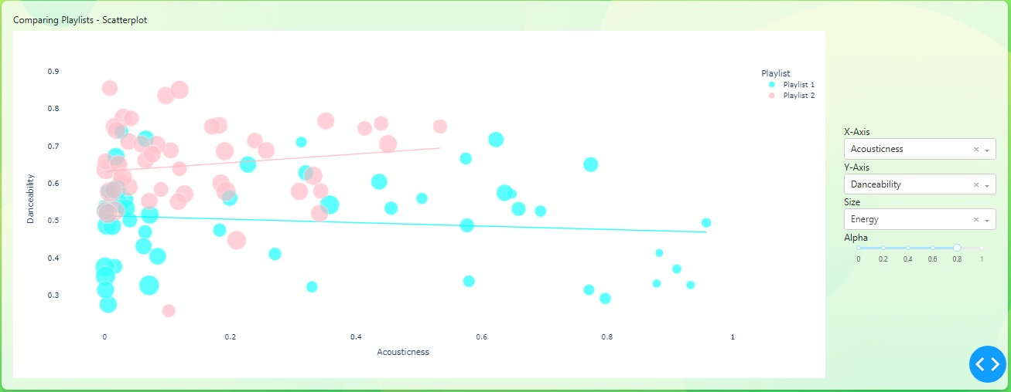
COMPARING PLAYLISTS - SCATTERPLOT

Slide 9
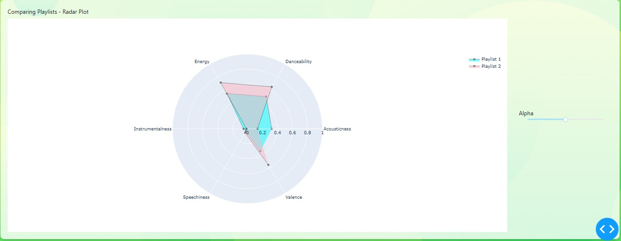
COMPARING PLAYLISTS - RADAR PLOT

Slide 10
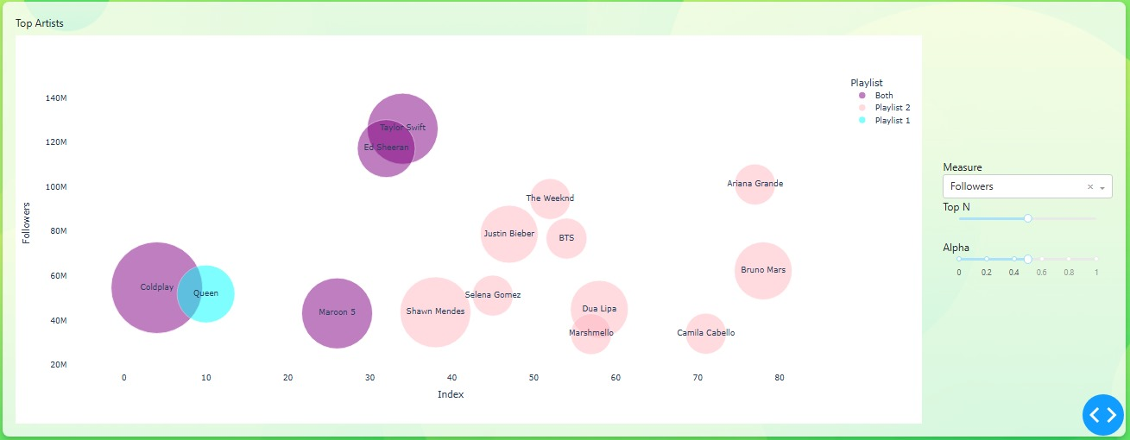
TOP ARTISTS

Slide 11
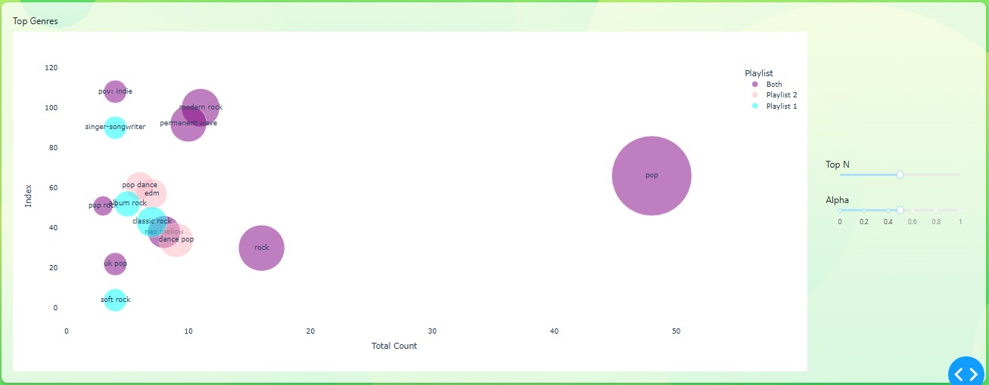
TOP GENRES

Slide 12
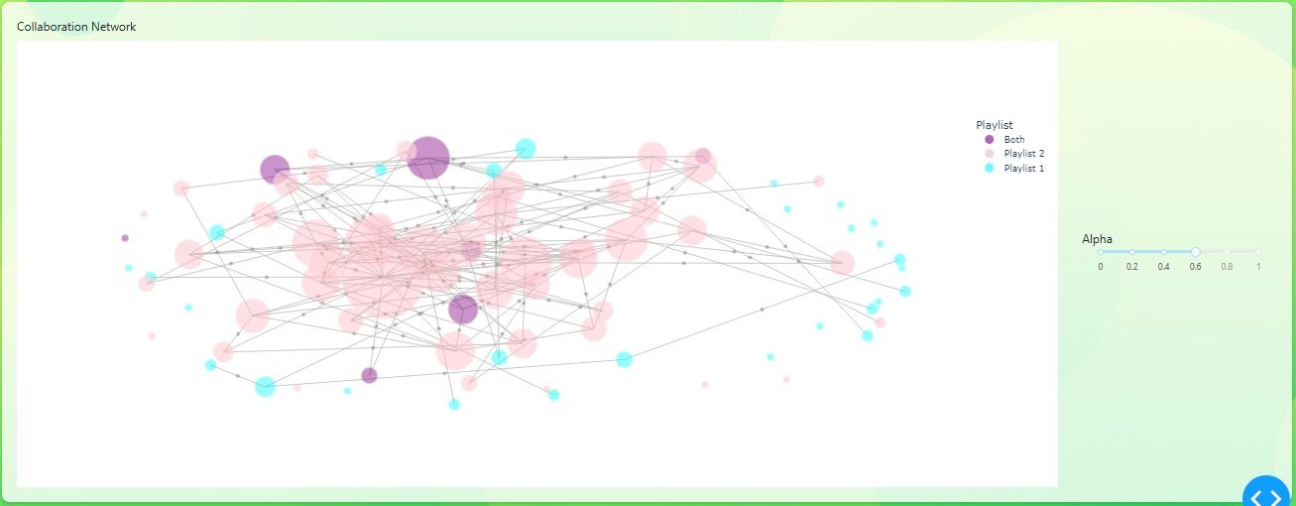
COLLABORATION NETWORK

Slide 13
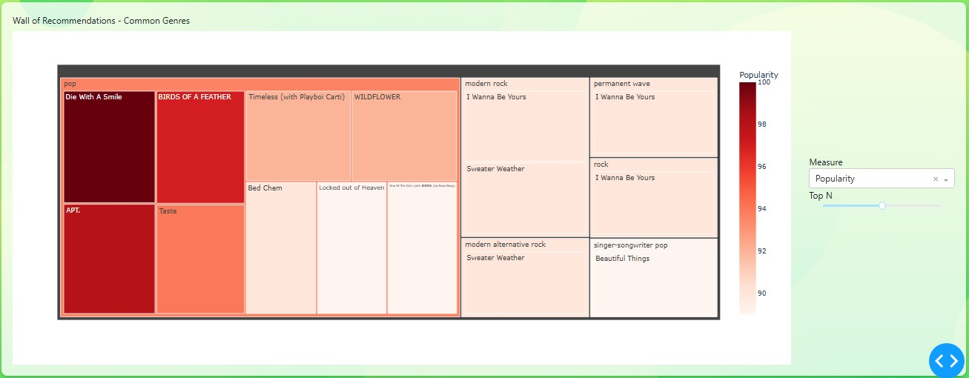
WALL OF RECOMMENDATIONS - COMMON GENRES

Slide 14
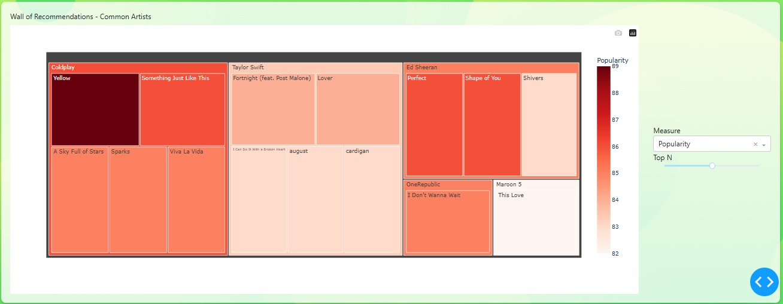
WALL OF RECOMMENDATIONS - COMMON ARTISTS

Slide 15
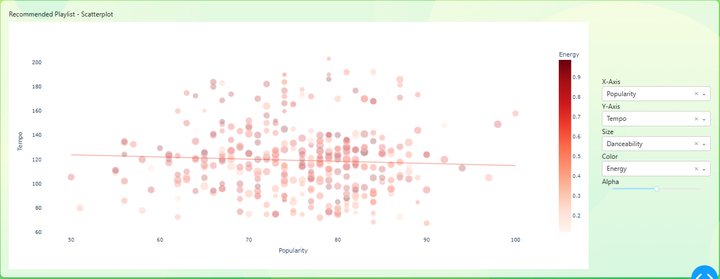
RECOMMENDED PLAYLIST - SCATTERPLOT

Slide 16
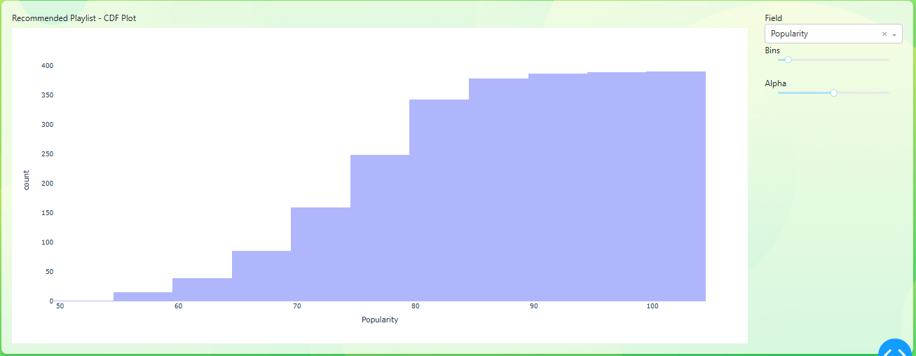
RECOMMENDED PLAYLIST - CDF PLOT

Slide 17
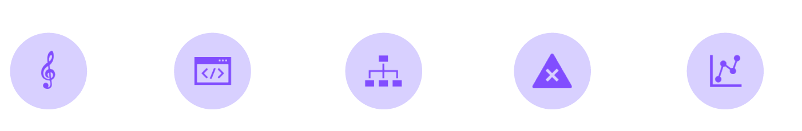
OUTCOMES
DIVERSE VISUALIZATIONS,
SUCH AS SCATTERPLOTS AND TREEMAPS, ANALYZE AND COMPARE SONG FEATURES IN PLAYLISTS.
USER-FRIENDLY CONTROLS, LIKE SLIDERS AND SELECTION MEASURES, ENHANCE THE INTERACTIVE EXPERIENCE.
GESTALT PRINCIPLES GUIDE THE DESIGN FOR EFFECTIVE PATTERN PERCEPTION AND GROUPING CONTINUITY.
CONSIDERATIONS FOR BALANCE AND RESTRAINT ARE EMPHASIZED TO AVOID COGNITIVE OVERLOAD AND DISJOINTED DISRUPTION.
INSIGHTS INTO MUSIC DATA ARE DERIVED FROM MULTIDIMENSIONAL VISUALIZATIONS, PROMOTING INTUITIVE UNDERSTANDING.

Slide 18
LEARNINGS FROM CLASS APPLIED IN VISUALIZATIONS
In our class lectures, we explored visualization techniques such as Histograms/CDFs, Scatterplots, KDE, Treemaps, Collaboration Networks, Parallel Coordinate Plots, Word Clouds, Bubble Charts, and Radar Plots. These techniques were applied in our final visualizations to effectively analyze and present playlist data.
Summarizing Key Concepts Applied:
Gestalt Principles:
Proximity & Similarity: Used in scatterplots and network maps for clear grouping and pattern recognition.
Closure & Continuity: Employed in radar plots and CDF plots to ensure intuitive data comprehension.
Interactivity:
Dropdowns and sliders for attribute selection (e.g., bubble charts, treemaps, scatterplots).
Alpha adjustments for visual clarity in overlapping data.

Slide 19
LEARNINGS FROM CLASS APPLIED IN VISUALIZATIONS
Accessibility & Clarity: High-contrast colors and structured layouts for readability. Simplified navigation through interactive homepage design.
Design Principles: Leveraged size and color to highlight musical attribute’s prominence and playlist affiliations, ensuring clarity and visual impact.
Hierarchy: Structured visualizations to maintain a clear and intuitive layout for seamless exploration of data.
Color Gradients: Applied gradients to represent measure values effectively, enhancing readability and interpretability.
Dynamic Filters and Intuitive Controls: Integrated interactive filters and controls to enable users to explore data in-depth and customize insights.

Slide 20
END-TO-END WORKFLOW
Data Collection: Extracted playlist data such as artists, songs and it’s attributes like tempo, energy, danceability, and genre etc using the Spotify API.
Data Cleaning and Processing:
Ensured consistency and completeness.
Addressed missing values and transformed data for analysis.
Exploratory Analysis: Used Python libraries (Matplotlib, Seaborn) for initial analysis and static visualizations.
Visualization Tools: Built user-friendly dynamic dashboard using Plotly and Dash for interactivity.

Slide 21
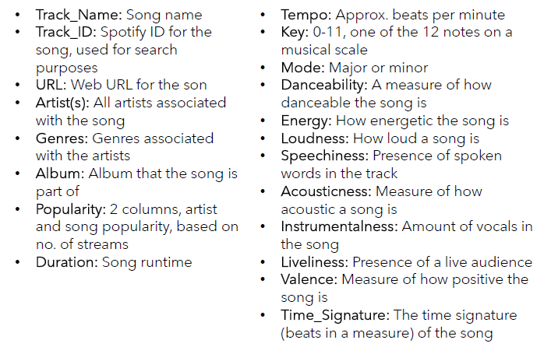
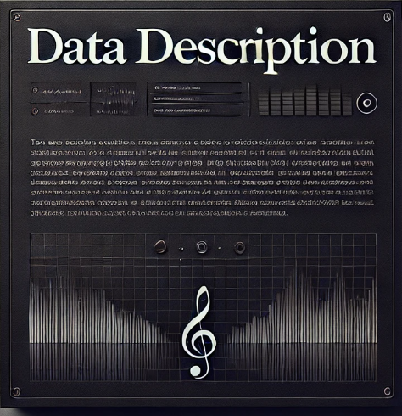
Format: Tabular format with mixed data types.

Slide 22
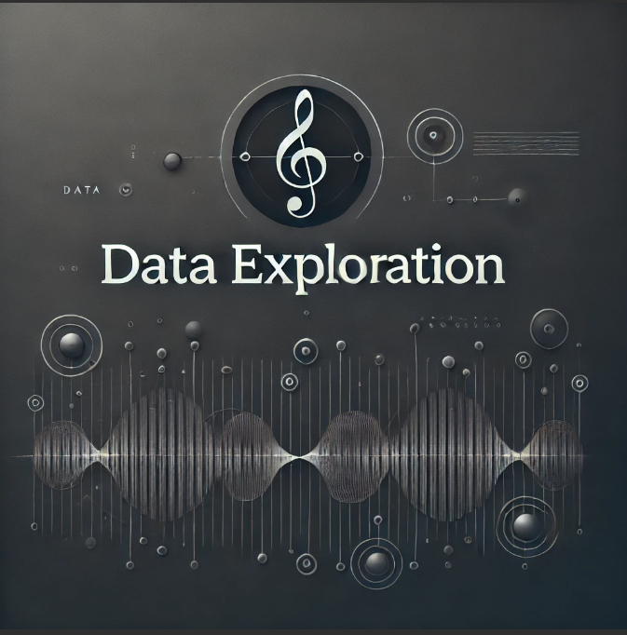
DATA EXPLORATION AND COMPARISON
Exploring the Dataset:
Objective: To uncover patterns and trends in Spotify playlists.
Approach: Iterative analysis starting with static visualizations for basic insights.
Initial Plots:
Histograms and KDE Plots
Scatterplots
Radar Charts
Parallel Coordinate Plots
Wordcloud

Slide 23
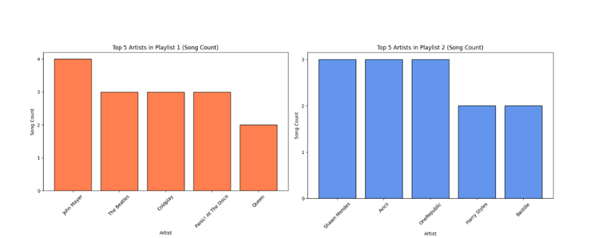
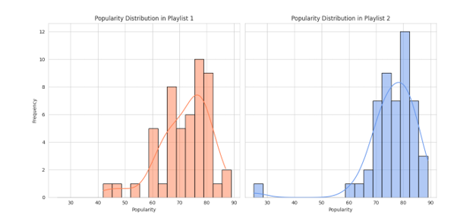
Histogram and KDE
The plot illustrates the relative occurrence percentages of the top 5 most frequent artists in two playlists through histograms, with Playlist 1 on the left and Playlist 2 on the right.
The plot visually compares song popularity distributions in Playlist 1 and Playlist 2. Each subplot features a histogram with 20 bins and a kernel density estimate, depicting song frequency at various popularity levels.

Slide 24
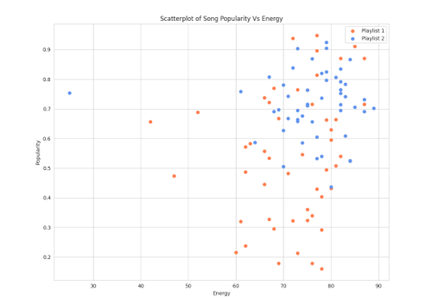
2) Scatterplot
The plot compares the relationship between song Popularity and Energy for two playlists (Playlist 1 in blue and Playlist 2 in green). Each point represents a song, with its position indicating both its Popularity and Energy values. The visualization aims to illustrate any patterns or differences in the distribution of these features across the two playlists.

Slide 25
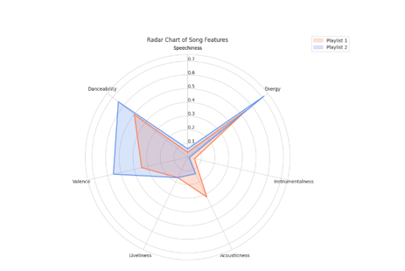
3) Radar Chart
This radar chart compares the mean values of selected song features (Speechiness, Energy, Instrumentalness, Acousticness, Liveliness, Valence, Danceability) between Playlist 1 and Playlist 2, offering a visual representation of their overall musical characteristics. The chart displays each playlist as a separate line, showcasing how they differ across the chosen features.

Slide 26
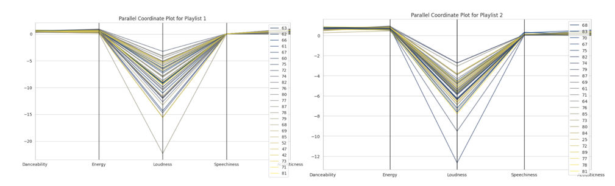
4) Parallel Coordinate Plot
The parallel coordinate plots compare the song features (Danceability, Energy, Loudness, Speechiness, Acousticness) across varying levels of popularity for Playlist 1 and Playlist 2. Each line represents a song, and its position on each axis indicates its feature value. The color intensity reflects the song's popularity, allowing for a visual assessment of feature patterns in relation to popularity within each playlist.

Slide 27
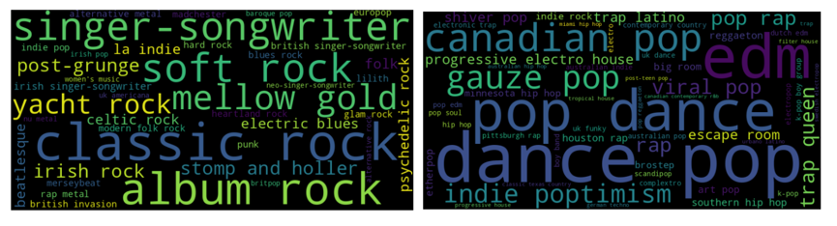
5) Wordcloud
The plot consists of two word clouds representing the most common music genres among artists in Playlist 1 and Playlist 2. Each word in the cloud corresponds to a genre, with the size indicating its frequency. The visual representation offers a quick overview of the genre distribution in each playlist, helping to identify the predominant music genres within the respective collections.

Slide 28
KEY ASPECTS EXPLORED IN OUR VISUALIZATION PROCESS
Analyzed Similarities and Differences: Conducted a detailed comparison of musical features (e.g., energy, danceability, and genres) across playlists to uncover patterns.
Developed Visual Representations: Designed visualizations, such as Radar Plots, Bubble Charts, and CDFs, to effectively capture and communicate differences and similarities.
Identified Common Traits: Leveraged data analysis to highlight shared musical attributes, providing insights into overlapping characteristics between playlists.
Generated Personalized Recommendations: Utilized insights from common traits to curate personalized song recommendations, enhancing user experience.
This structured approach combined data analysis with advanced visualization techniques to uncover meaningful insights and actionable outcomes.

Slide 29
REFERENCES
[1] “Spotify—About Spotify,” Spotify, Oct. 24, 2023. https://newsroom.spotify.com/company-info/
[2] “How to visualize Spotify music trends in Tableau.” https://www.tableau.com/blog/how-visualize-spotify-music-trends-tableau
[3] “Visualizing Spotify Data with Python and Tableau.” https://towardsdatascience.com/visualizing-spotify-data-with-python-tableau-687f2f528cdd
[4] “Spotify Song Attributes Analysis.” https://www.kaggle.com/code/krishnabhatt4/spotify-song-attributes-analysis
[5] “A simple guide to visualizing your Spotify listening data… badass-ly. ” https://thenextweb.com/news/a-simple-guide-to-visualising-your-spotify-listening-data-badass-ly
[6] “Stats for Spotify.” https://www.statsforspotify.com/
[7] “My Spotify Pie - Top artists - Top genres.” https://huangdarren1106.github.io/spotify-pie
[8] “Obscurify Music.” https://www.obscurifymusic.com/home
[9] “Compare your Spotify music taste! - Musictaste.space.” https://musictaste.space/

Slide 30
Thank you

